Slide 1



MERCURY TOURS
IGATE is now a part of Capgemini

Slide 2
TEAM MEMBERS
MUZAMMIL ALEEM KHAN
MAYUR MAHADEV MORE
MANALI LAXMIKANTH CHOUDHRY
NAMAN AWASTHI
NILESH PRADOSHKUMAR KALWAR

Slide 3
Application link
http://www.newtours.demoaut.com/

Slide 4
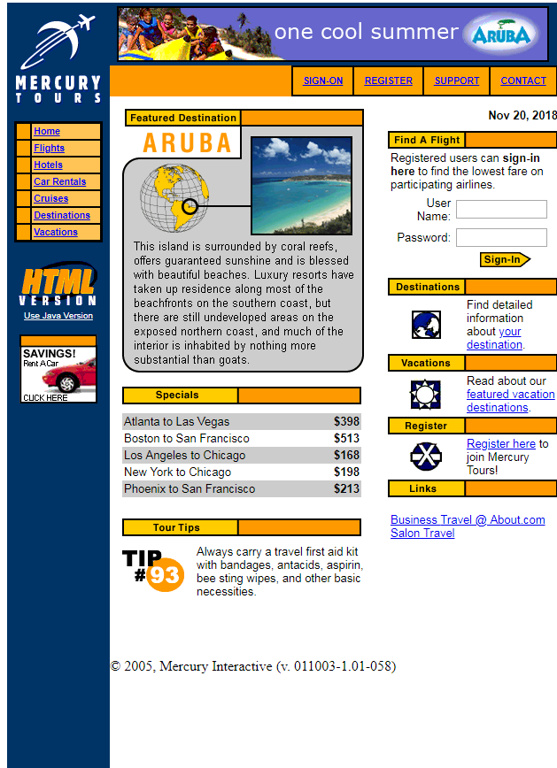
MAIN PAGE

Slide 5
OVERVIEW OF THE PROJECT
Mercury tours is a website use to book flight tickets between few cities.
The website has various different features and functionalities which the user can experience when registered to the website.
This travel site is easy to access and can be used by any user.
The website consist of 7 to 8 pages which have been described ahead.

Slide 6
HOME

Slide 7

HOME
Home button is one of the important hyperlink which is use to display the main page of the website.
It is located at the left side of the page below the logo of the website.
It is the only functional button to the user along with the “Register button” when the user is not register to the webpage.

Slide 8
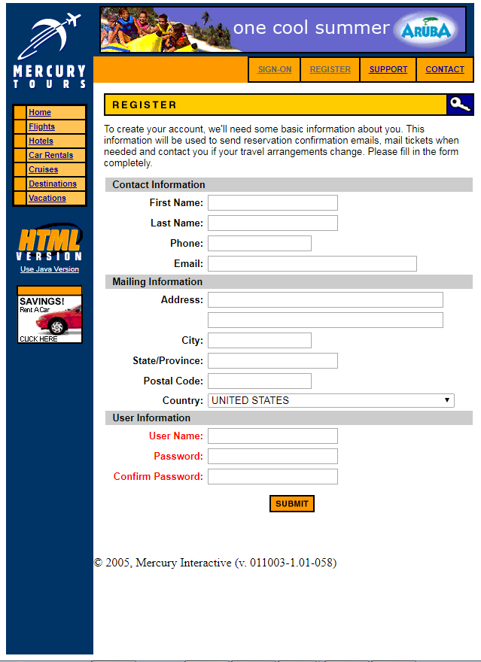

REGISTER

Slide 9

REGISTER
If the user is new to the website and want to explore the contents of the website he/she has to register him/her to the website.
The user has to enter all its valid data in the respective textboxes.
There are various rules which are to be followed with respect to various textboxes.
Once the user has entered all the valid details the user has to click on the submit button at the bottom of the registration form.

Slide 10
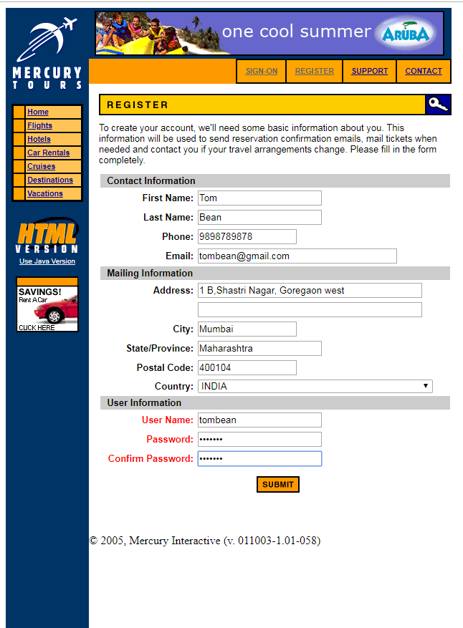
REGISTER

Slide 11
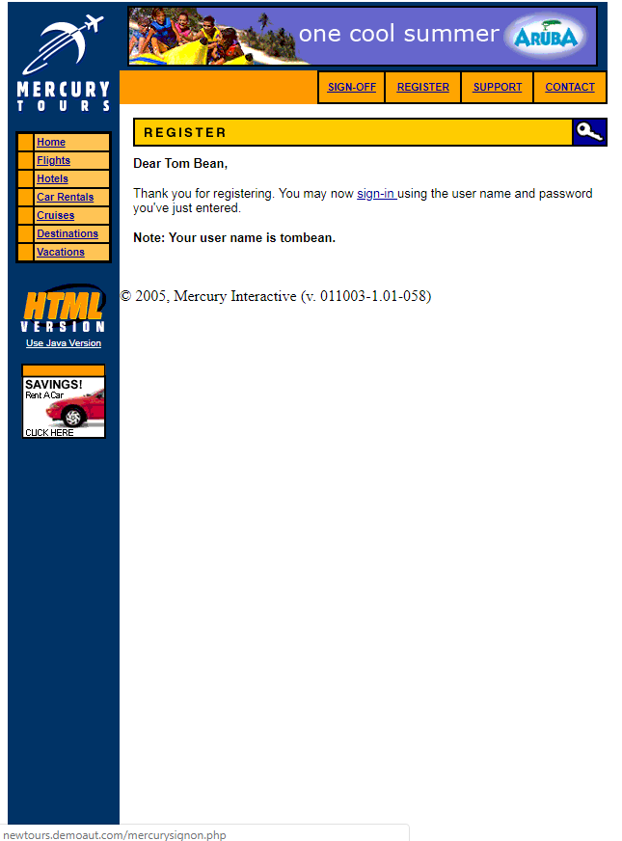
SUCCESS MESSAGE

Slide 12
SUCCESS MESSAGE
On clicking the “SUBMIT” button the user gets a message stating that user has register successfully and now can sign-on to the page.
This webpage consist of a “SIGN-ON” hyperlink which will direct the user to the SIGN-ON page.

Slide 13
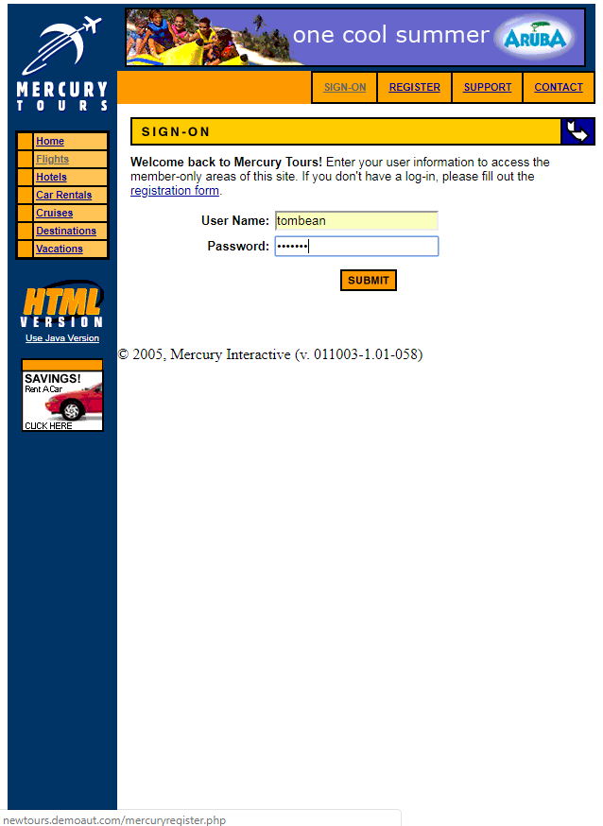
SIGN-ON PAGE

Slide 14

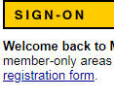
SIGN-ON PAGE
Once the user clicks on the “sign-on” hyperlink on the success message page the user is redirected to the “SIGN-ON PAGE”.
If the user is already registered to the website than he can directly sign on from the home page.
The redirected SIGN-ON PAGE has a hyperlink “registration form” which again redirects to the form if incase a new user has clicked on SIGN-ON button without registration.

Slide 15

SIGN-ON PAGE

Slide 16
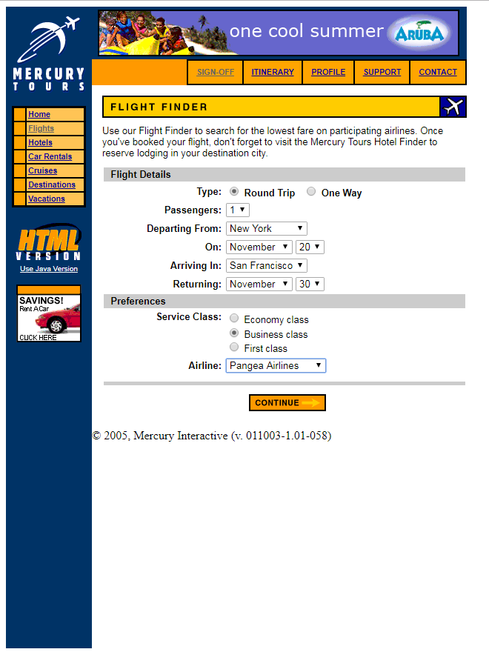

FLIGHT FINDER PAGE

Slide 17
FLIGHT FINDER PAGE
Once the user has signed-on the user is directed to the “FLIGHT FINDER PAGE”.
Here the user will enter the details of source and destination of flights, with the desire dates he want to travel too.
Once all the details according to the user is filled the user will click on the “CONTINUE” button at the bottom of the page.

Slide 18
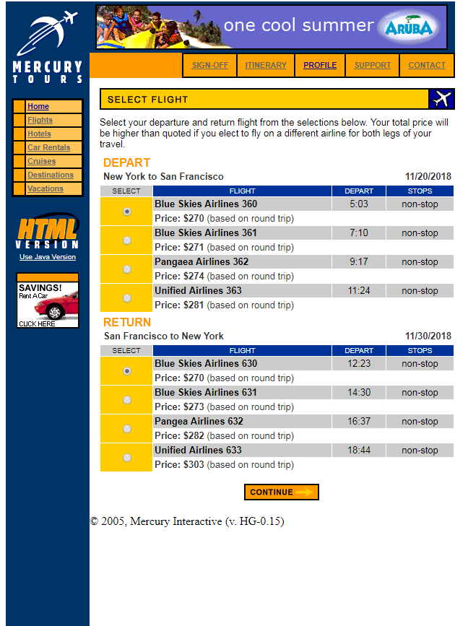
SELECT FLIGHT

Slide 19
SELECT FLIGHT
Once the user is directed to this page the user can select the flights according to his/her choice.
Here the user has to select both depart and return flight for the trip.
Once the user has selected the flight of his choice the user clicks on “CONTINUE” button to redirect to the next page.

Slide 20
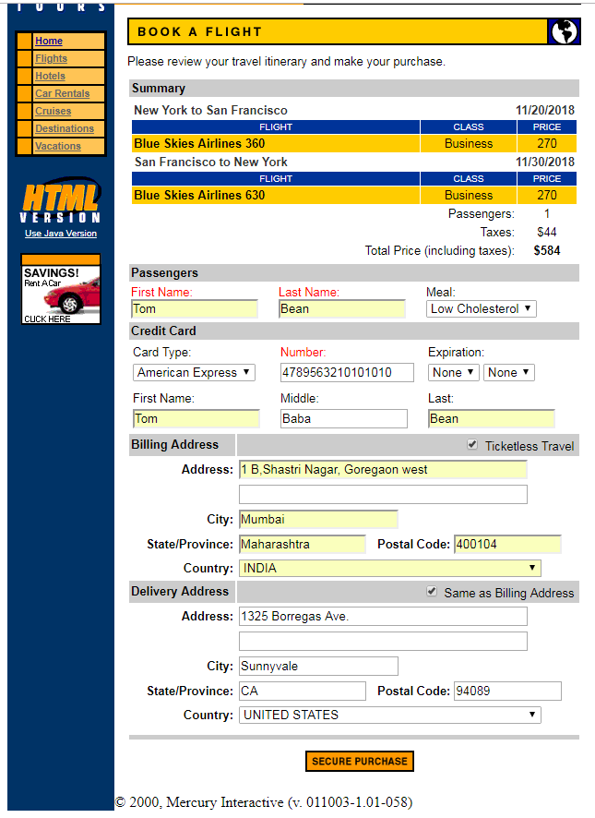
BOOKING DETAILS

Slide 21
BOOKING DETAILS
This page is divide into 3 parts namely: Passenger details
Billing Address
Delivery Address
The user enter the details of the passenger in the first part of the page.
The second part of the page is the important part as it is related to the billing of the tickets the user has select. Here the user enters his payment card details.
The third part is the delivery address where the hard copy of the ticket which is been booked is sent.
After all the 3 parts are filled the user clicks on the “SECURE PURCHASE” button to go to the payment gateway page.

Slide 22
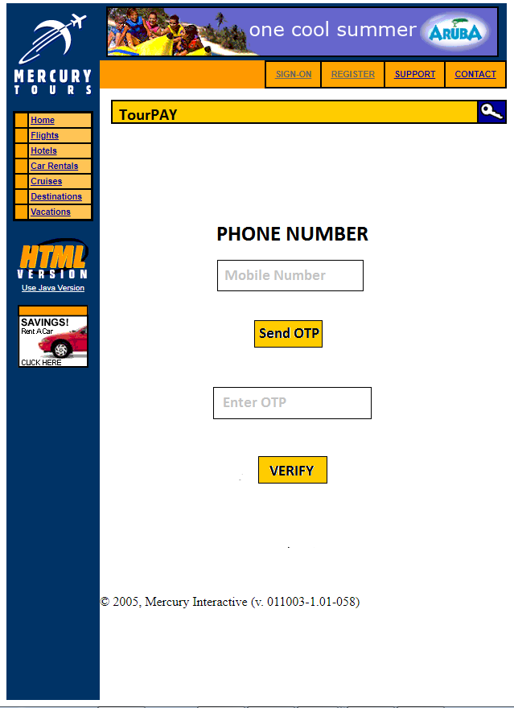
PAYMENT GATEWAY

Slide 23
PAYMENT GATEWAY
On clicking the “SECURE PURCHASE” button the user is directed to the payment gateway for verification of the card.
Here the user has to enter the valid mobile number related to the bank and click on “SEND OTP” button.
Once the OTP is received the user enter the OTP in the OTP textbox and clicks on verify.
When the OTP is verified the user is directed to the ticket generation page.

Slide 24
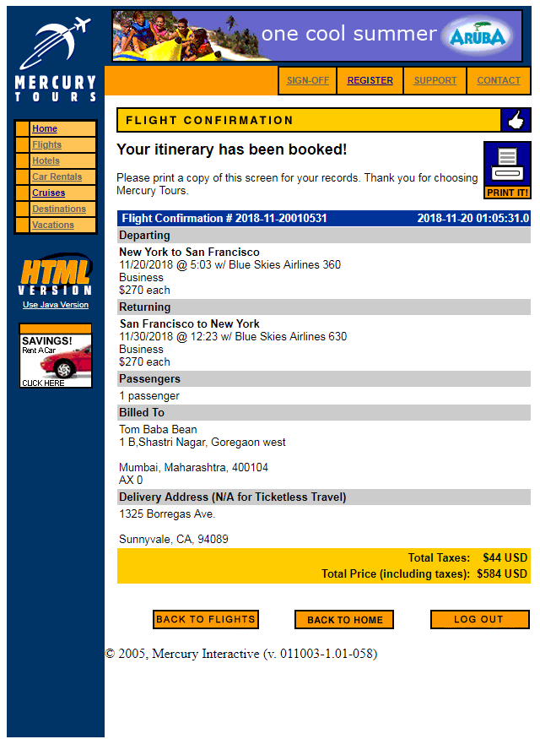
FLIGHT CONFIRMATION

Slide 25
FLIGHT CONFIRMATION
Once the verification of the mobile is done the ticket gets confirmed and the user is directed to the last page of the website where the confirmed ticket of the journey is been displayed.
The user can take a print of the ticket by just clicking on the “PRINTER” icon on the top right side of the page.
Once the printout is generated the user has 3 options to perform using 3 different buttons at the bottom of the page.

Slide 26
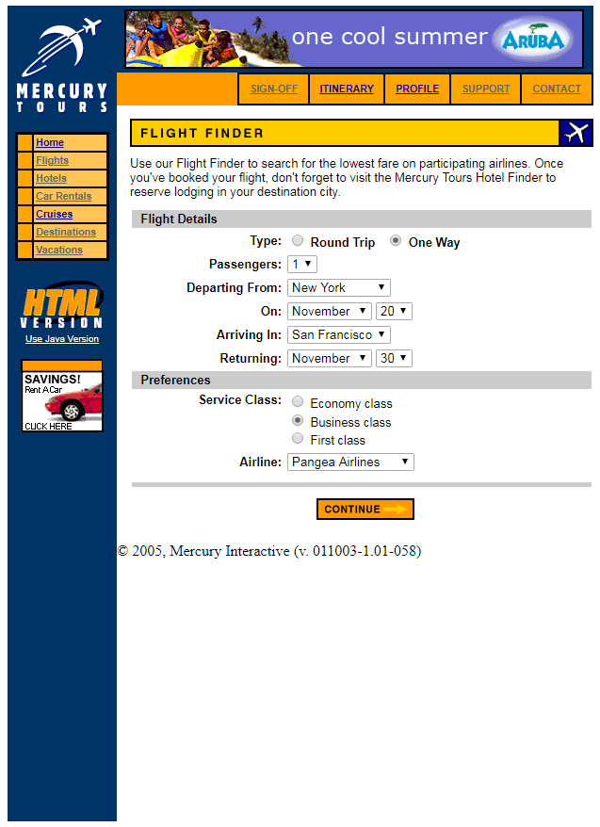
FLIGHT CONFIRMATION
1)By clicking “BACK TO FLIGHT” the user is redirected to the first page of flight booking.
2) By clicking ”BACK TO HOME” the user is redirected to the home page of the website

Slide 27
FLIGHT CONFIRMATION
3) On clicking the “LOGOUT” button the is logged out of the website and is redirected to the home page.

Slide 28
USE CASE

Slide 29
Actors
USER
(ACTUAL)
ADMIN
(EXPECTD)
BANK
(EXPECTED)

Slide 30
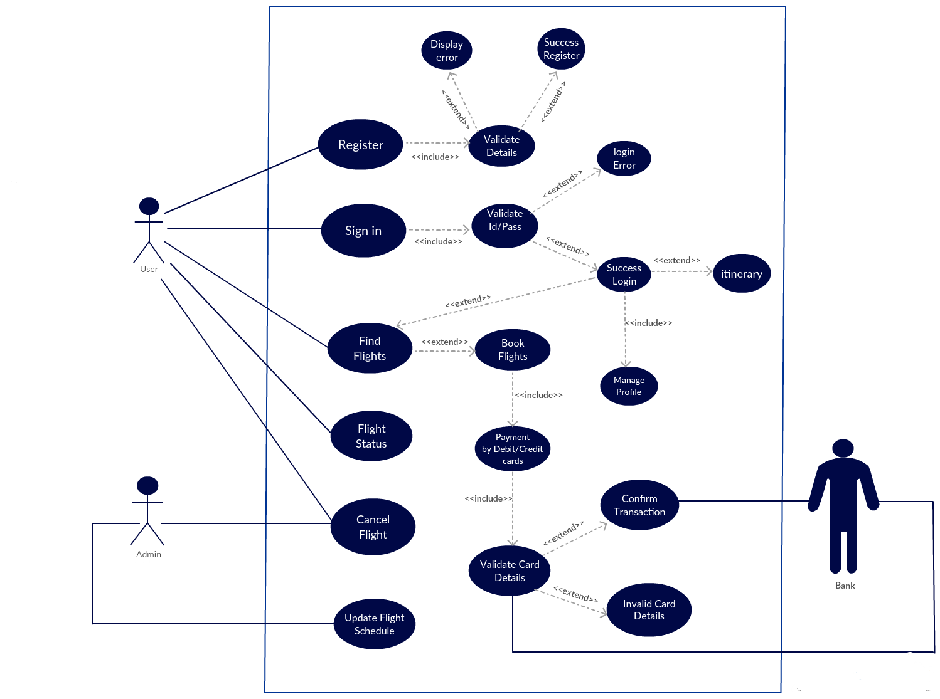
USE CASE DIAGRAM (EXPECTED)

Slide 31
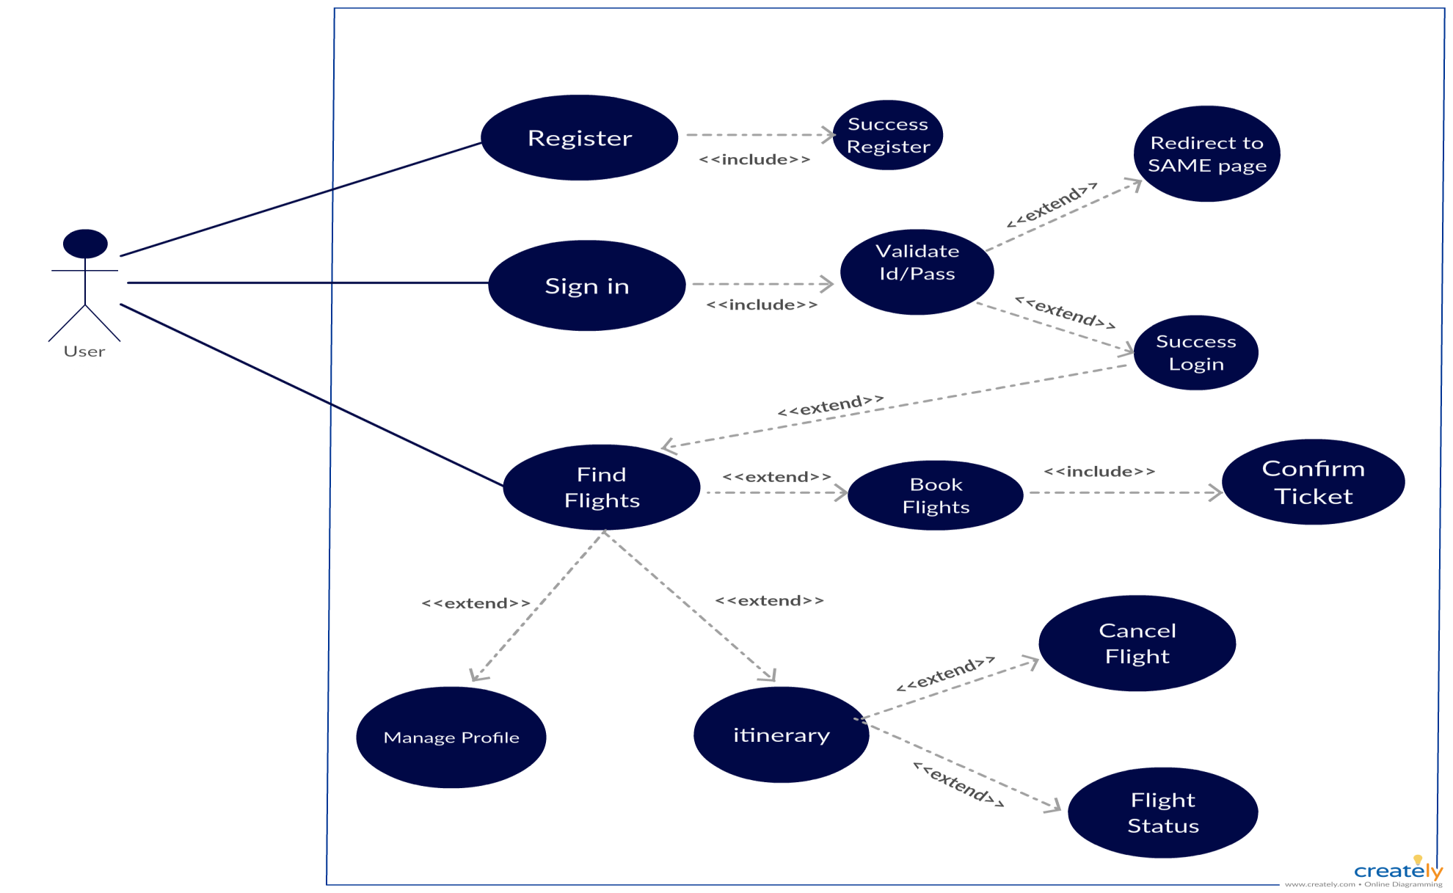
USE CASE DIAGRAM (ACTUAL)

Slide 32
TEST CASES
There are basically four different types of test cases present in this project which are as follows:
INTERSYSTEM
SECURITY
USESCASE BASED
STATE TRANSITION

Slide 33
TEST CASES
LINK to view the INTERSYSTEM TEST CASES:
LINK to view the SECURITY TEST CASES:
LINK to view the USECASE BASED TEST CASES:
LINK to view the STATE TRANSITION BASED TEST CASES:

Slide 34
DEFECT REPORT
LINK to view the DEFECT REPORT for the above TEST CASES:

Slide 35
TRACEABLITY MATRIX

Slide 36
Thank You

